Slide 1
2023-2024 9th Grade Registration Information
Lakewood Ranch High School
Notes:
Hello to the Lakewood Ranch High School Class of 2026. Wow, 2026! Sounds strange doesn’t it? Seems so far off in the future, but here we are talking with you about registering for high school. The entire faculty and staff at LRHS look forward to having you join us in August and we hope that you are as excited about becoming a Mustang as we are to welcome you to campus!
We realize that this has been yet another tough year for everyone. For example, you are watching a video presentation about registration instead of the LRHS counselors meeting with you in person. Although we regret that lost opportunity, we hope that you find this video as informative as if we were in the auditorium guiding you through this information.
Registration for high school can be both exciting and intimidating at the same time. Fear not… everything you might need to know will be reviewed today.

Slide 2
School Information
Mascot: Mustangs
Colors: Green, Silver & Black
Incoming Freshmen: 600
Enrollment: 2400
First Day of School: August 10, 2023
Hours: 7:30 – 2:25
Notes:
We wanted to review with you some of the basics about LRHS before moving on to the registration process. First and foremost as future Mustangs, when back to school shopping this year, make sure you stock up on our school colors of green, silver, and black. You will be a member of a freshmen class of around 685 and a part of a larger group of over 2400 students. Does that seem a bit overwhelming? Don’t worry, the campus is set up in such a way that it is easy for students to navigate their way around, and there will be plenty of staff on hand the first few days of school to point them in the right direction. The first day of school is scheduled for August 10th and perhaps most importantly – make sure your students set their alarm clocks early! The first bell rings at 7:30, which is quite a change from their current school schedule! Traffic can be very heavy so if your students can ride a bus to school, they should. This is by far the easiest way to make sure they are here on time. Although you do have to be here bright and early, we do dismiss at 2:25 so there is plenty of time in the afternoon for clubs and athletics and perhaps more importantly - time for homework.

Slide 3
Graduation Requirements
Earn 24 Credits including the following:
4 English
4 Math (including Algebra 1 and Geometry)
3 Science (including Biology)
3 Social Studies (World History, United States History, US Government and Economics)
1 HOPE (Health and PE)
1 Fine Art
8 Electives
Earn an un-weighted cumulative GPA of 2.0 or higher
Complete at least one course online.
Pass the required state assessments (10th Grade FSA/ELA and Alg 1 EOC)
Notes:
So even though your students are not even on our campus yet, we want to take some time to talk with you about what they need to do to graduate. Believe it or not, four years will fly by and our goal is to ensure that all students are prepared to walk across the stage at the end of the senior year and receive a well deserved diploma.
You will hear a lot about credits during your students’ time in high school. In a little bit, we will talk about how students earn credits, but for now, we just want to review with you what is expected of all students for graduation.
Review credits and requirements.
If your student has taken a high school course while in middle school (for example, English 1 Honors, Algebra 1, etc.), these do count towards the 24 credits that are required.

Slide 4
Testing Requirements
Level 3 or higher on the Grade 10 FSA ELA (Writing & Reading)
Level 3 or higher on the Algebra 1 End of Course (EOC) Assessment
Biology EOC counts 30% of the final course grade
Geometry EOC counts 30% of the final course grade
US History EOC counts 30% of the final course grade
Notes:
Testing. Everyone is familiar with testing, right? The Reading & Writing and Math tests that your students have been taking for years continue on in high school. Although there are many assessments that students will take, there are a few that are required for graduation. Students must pass the first two assessments listed on this slide in order to earn a diploma. In both 9th and 10th grade, students will take the Florida Standards Assessment in English Language Arts. They must score a level 3 or higher on the 10th grade assessment for graduation.
They will also need to score a level 3 or higher on the Algebra 1 End of Course Exam (EOC). Some students may have already taken this exam, or may be taking it in May of this year if they are enrolled in Algebra 1. If a student takes the EOC in middle school and passes, they have met this graduation requirement.
They will also take EOCs in Biology, Geometry and US History. Although these do count as 30% of their course grade (meaning students should be motivated to do the best they possibly can), they do not have to pass them for graduation.
When your student prepares to take their FSAs this year, please encourage them to take the test seriously and to take their time completing it. Even if your student doesn’t need to pass in order to be promoted, if they score below a level 3, they may have to give up one of their elective courses to take an Intensive Reading or Math class. These are not designed to be a punishment but as a way to help your student prepare for the assessments they will take in high school.

Slide 5
HOPE Requirement
A student can waive the HOPE requirement in one of two ways:
Participate in two complete seasons of an interscholastic sport at the Junior Varsity or Varsity level.
Complete two years in an ROTC class. This will waive the full credit in HOPE and the full credit in Fine Arts.
**Students who waive HOPE by participating in LRHS athletics are required to submit a signed waiver prior to graduation.
Notes:
HOPE is a graduation requirement, and the course focuses on preventative health while emphasizing the importance of maintaining a healthy balance of physical, mental, social, emotional and mental health. Students who meet one of the criteria indicated on this slide are eligible for a HOPE waiver. We have linked the waiver into this presentation so you can familiarize yourself with it. Students MUST submit a signed waiver to their counselor before graduation in order to meet the requirement. Please make sure your student does not wait until the last minute to submit this waiver.

Slide 6
Performing Art Requirement
Students must complete one credit in a Performing/Fine Art for graduation.
In addition to all art, music, drama and speech courses, several other courses have been approved to meet the credit in performing/fine art required for graduation. These are listed on page 2 of the Freshman Course Guide.
Notes:
In addition to the HOPE requirement, students are also required to complete one credit in a Performing/Fine Art. Please review page 2 of the Freshman Course Guide for courses that will satisfy this requirement. Students have the option of completing this requirement either on the LRHS campus or online via FLVS.

Slide 7
Grades
Quarter grade – End of each 45 days
Semester exam grades – One per class at the end of each semester.
Semester grades – End of each 90 days
Students will also receive a progress report grade midway through each quarter.
Notes:
Students will receive quarterly grades at the end of each grading period as indicated on the slide. It is important to remember that only semester grades are reflected on a student’s transcript.

Slide 8
Grade Calculation
For any course that has an EOC (Algebra 1, Geometry, Biology, US History) the semester grade is calculated as:
Each quarter - 35%
Semester exam - 30%
For all other courses, the semester grade is calculated as:
Each quarter – 40%
Semester exam – 20%
Notes:
Certain courses have an end-of-course, or EOC, assessment that is calculated into their grade. The courses that have the EOC assessment requirement are Algebra 1, Geometry, Biology and U.S. History. While every student is required to take each of these assessments, they only have to pass the Algebra 1 EOC in order to graduate.

Slide 9
Earning Credits
Credits are awarded at the end of each semester.
.50 credit is earned for each semester grade of D or higher.
Each semester, students have the opportunity to earn 3.5 credits.
3.5 credits per semester equals 7 credits per year.
Semester grades, as well as the cumulative GPA, are reflected on the high school transcript.
Notes:
Students have the opportunity to earn 7 credits each year. It is not uncommon for a student to fail a semester of a specific course, or to fail both semesters. If a student fails part or all of a course, they have the opportunity to recover the credit. This can be accomplished in a few ways. The student can re-take the course online via FLVS. Or, the student can re-take the course during summer school if it is being offered. Lastly, the counselor can enroll your student in a “Research” class period. The Research class counts as elective credit and provides your student the opportunity to make up the coursework in a supervised, on-campus lab. Please keep in mind that upperclassmen are prioritized over underclassmen for lab space.

Slide 10
Grade Point Average (G.P.A.)
Each letter grade is equal to a point value.
Grade | Unweighted Courses | Weighted Honors Courses | Weighted AP & Dual Enrollment Courses
A | 4 | 4.5 | 5
B | 3 | 3.5 | 4
C | 2 | 2.5 | 3
D | 1 | 1.5 | 2
F | 0 | 0 | 0
Notes:
This slide will help you to understand how a student’s grade point average, or GPA, is calculated.

Slide 11
Registration Guidelines

Slide 12
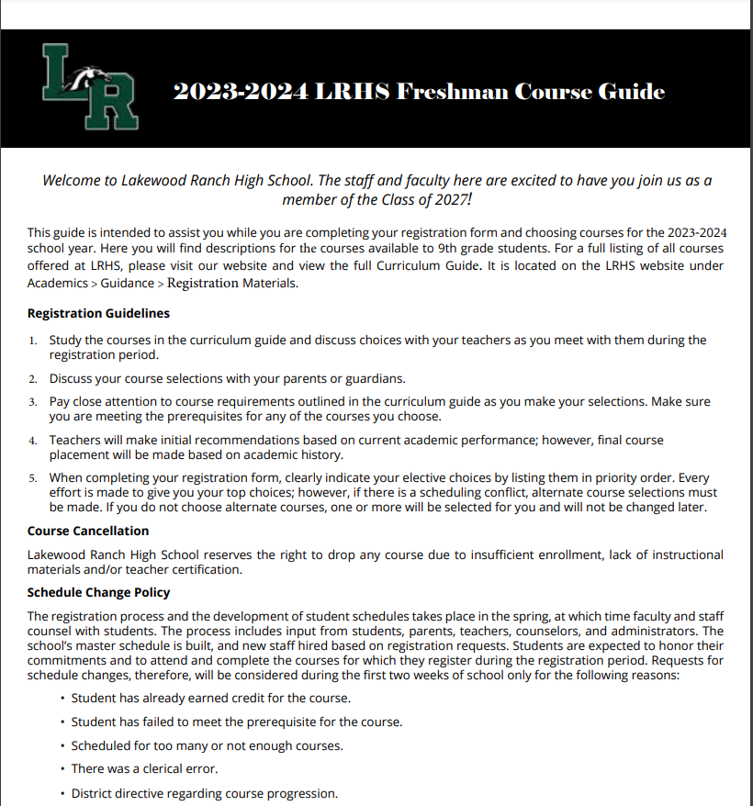
2023-2024 Freshman Course Guide
Notes:
When the LRHS counselors visit with your students next week, they will be giving your students the 2022-2023 Freshman Course Guide. Students will use the information from this guide to complete their 9th grade Course Selection Form.

Slide 13
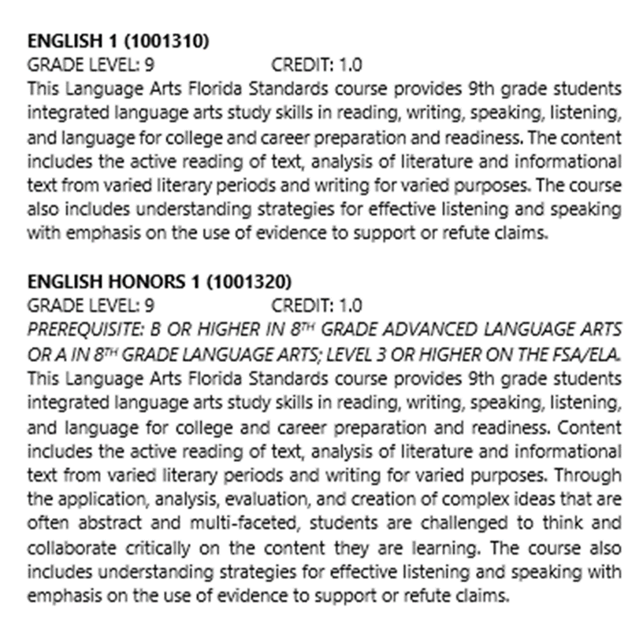
2022-2023 Freshman Course Guide
Notes:
When reviewing the Course Guide with your students, make sure to thoroughly read the course descriptions. Some courses have prerequisites, which is my next topic of discussion for this presentation.

Slide 14
What is a Prerequisite?
The term prerequisite refers to a requirement students must meet prior to enrolling in a certain course.
For example, for a student to enroll in English 1 Honors, the student must have the following: a B or higher in 8th grade Advanced Language Arts or an A in 8th Grade Language Arts as well as a Level 3 or higher on the FSA ELA.
Notes:
Please make sure that your student only selects courses that they are eligible to take. Students will not be scheduled into courses that have a prerequisite (even if they are selected on the form) unless they meet the requirements of the course.

Slide 15
Registration Form
Please complete the top portion of the registration form with your last name, first name, and phone number.
**Please make sure to print neatly.

Slide 16
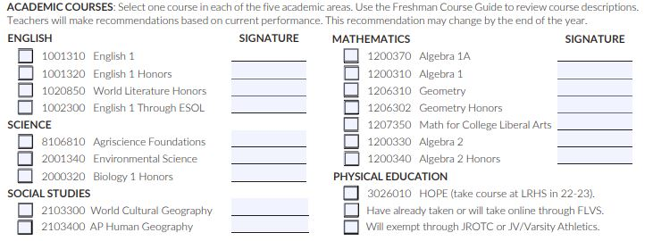
Registration Form Guidelines
Select your core (required) courses, making sure that you have met the prerequisite(s) outlined in the curriculum guide. Also, make sure you have the appropriate teacher’s approval.
Notes:
Please make sure to remind your student to get their current teacher’s signature next to the appropriate core content course they have selected on the form. This is extremely important to ensure appropriate student placement.

Slide 17
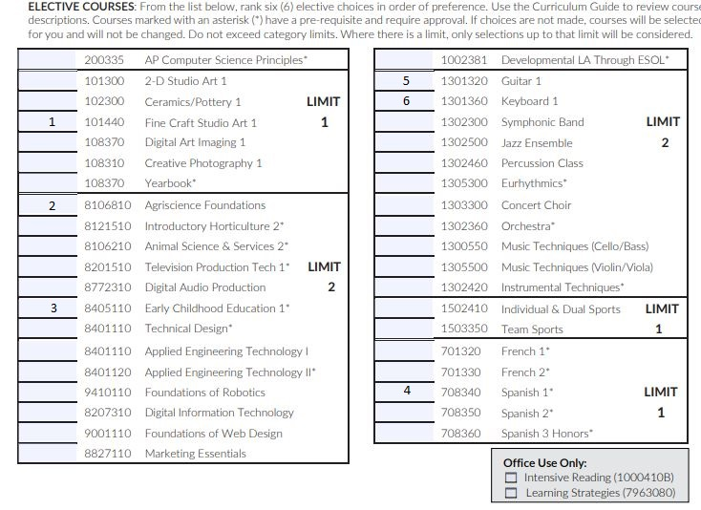
Registration Form Guidelines
Clearly indicate your elective choices by ranking them, where indicated, in priority order.
Please use numbers instead of symbols to indicate your selections.
All courses marked with an asterisk (*) have a prerequisite and require teacher approval.
Notes:
Your students will have the opportunity to choose 6 electives. As you can see, students can select from a variety of electives. It is very important that students rank their elective choices from 1 (the one they want the most) to 6 (the one they want the least). Where category limits are indicated, students must not choose more than the indicated number. Refer to the example shown on this slide. Students MUST select 6 electives and rank them. If they do not choose 6, or they do not rank them properly, counselors will choose their electives and rank them.

Slide 18
Schedule Changes
Requests for schedule changes will ONLY be considered during the first two weeks of school for the following reasons:
1. The student has already earned credit for the course.
2. The student failed to meet the prerequisite for the course.
3. The student is scheduled for too many or not enough courses.
4. Clerical error(s)
5. District policy regarding course progression.
**Please do not contact your student’s counselor to request a schedule change if the request does not meet one of the above criteria.
Notes:
It is important to know that counselors will only consider schedule change requests during the first two weeks of school. Beyond that, it is very difficult for a student to get caught up in a new course. Counselors will only consider schedule change requests for the reasons outlined on this slide. The reason for this is because the master schedule is developed based on student enrollment in each course. Teaching staff allocations are determined by this, as well. So, once student schedules are set (based on courses selected by your students), we prefer that they stay in place. Unless your student’s request meets one of the above criteria, please do not contact your student’s counselor to request a schedule change.

Slide 19
Frequently Asked Questions
Q: What if I don’t agree with the teacher’s recommendation for one of my student’s core courses?
A: A Level Change request can be initiated within the first few weeks of school, if appropriate.
Notes:
On the next few slides are some questions that are frequently asked by parents of incoming 9th grade students. If you don’t agree with a teacher recommendation made for your student, you should first contact your child’s teacher. The teacher is in a better position to explain course content, pacing and sequencing than your student’s counselor. After speaking with the teacher, if you would still like to pursue a level change for your student, you can contact their counselor.

Slide 20
Frequently Asked Questions
Q: What if my student doesn’t like one of their classes?
A: While we understand that students will enjoy some classes more than others, we will not make schedule changes for any of the following reasons:
Desire for a different teacher
Wanting to be in a class with friends
Wanting a different lunch period
Elective is not what student thought it would be
Notes:
Just as we outlined criteria for making schedule changes, we wanted to share some of the reasons we will not adjust schedules. This is not meant to be punitive or diminish your student’s enjoyment of their freshman year. Again, course selections drive the master schedule as well as staffing numbers. Additionally, part of what we are tasked with as educators is teaching students to be adaptable, flexible and resilient. As adults, we have the wisdom to know that there were some classes in high school and/or college that we didn’t particularly enjoy. Similarly, there were some teachers we collaborated with better than others. However, as we prepare students to some day enter the workplace, they must be able to work in a variety of environments with a variety of people. This is a skill we can start building now as they enter high school.

Slide 21
Frequently Asked Questions
Q: How many community service hours do students need for graduation?
A: Although hours are required for Bright Futures scholarships, there is no community service requirement for graduation.
Notes:
It is important to remember that while community service hours are not required for graduation, they are required for students to be eligible for scholarships through Bright Futures.

Slide 22
Frequently Asked Questions
Q: How do students record community service hours?
A: Forms and guidelines can be found on the LRHS website. Hours completed the summer before 9th grade can count for high school.
Notes:
On this slide, we have included a link to the LRHS webpage where you will find the guidelines and documentation forms.

Slide 23
Frequently Asked Questions
Q: Are students required to take a world language to graduate from high school?
A: While there is no world language requirement for high school graduation, students are encouraged to take at least two years of a world language if they plan to attend a four-year college/university. Three or more years is highly recommended.
Notes:
There is no world language graduation requirement. However, colleges and universities like to see students take at least 2 years of the same language. Three or more years of the same language is looked upon even more favorably.

Slide 24
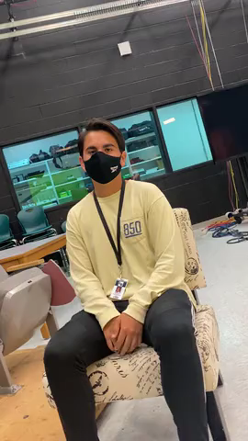
What advice would you give to an incoming 9th grade student?
Notes:
Now it’s time to hear from some of our “veteran” LRHS students about what they think incoming 9th grade students should know!

Slide 25
What advice would you give to an incoming 9th grade student?

Slide 26
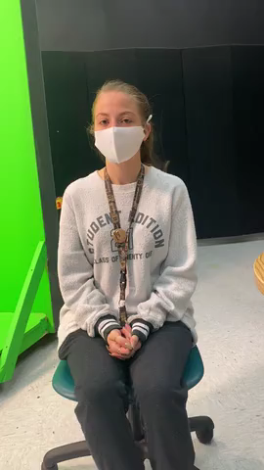
What advice would you give to an incoming 9th grade student?

Slide 27
LRHS COUNSELORS
Melissa Alter (Ho-Me)
Jenna Moser (Sb-Z)
Terry Rey (A-C)
Monica Shackelford (D-Hi)
Tasia Verno (Mi-Sa)

